Slide 1
Introduction to Data science
Final assignment replacement project
Made by:
Fares ashraf 170916

Slide 2
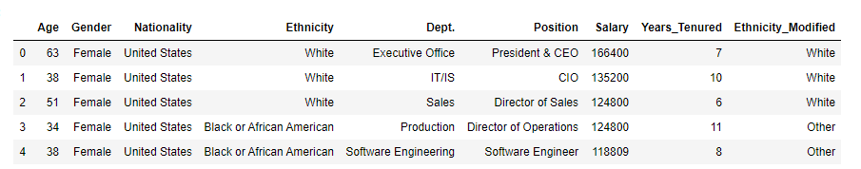
Part one: Data Ingestion, Integration and Quality Issues
We read the data of the company from the csv file.
We got rid of the un-needed columns and added the necessary columns.
Some data quality issues has been dealt with.
The head of the final Data Frame:

Slide 3
Part one: Data Ingestion, Integration and Quality Issues
Different types of data integration, and which is better for our case.
Challenges in data integration.
Data quality problems.

Slide 4
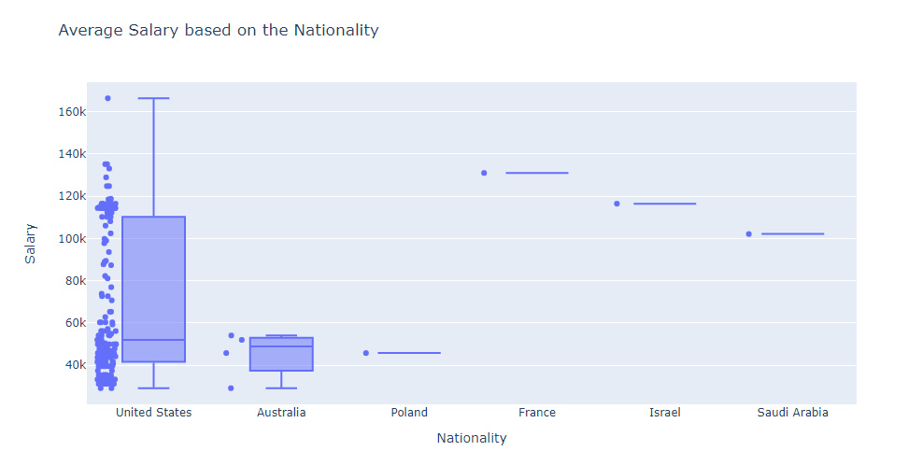
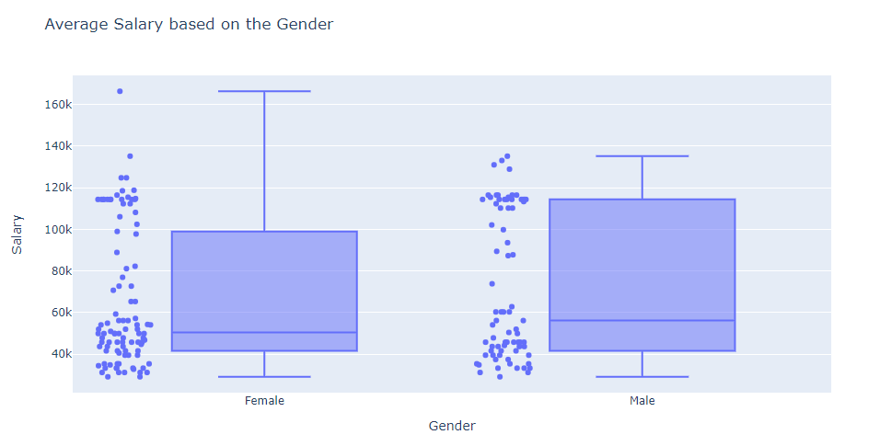
Part two: Exploratory Data Analysis 2.1) average salary visualization.
After getting the data frame we started visualizing the average salary with each of nationality, gender, department, and Ethnicity.
Box plot of the average salary vs. Nationality:
Box plot of the average salary vs. Gender:

Slide 5
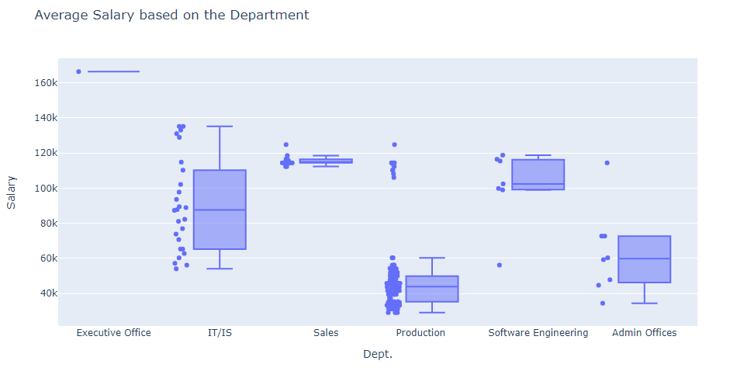
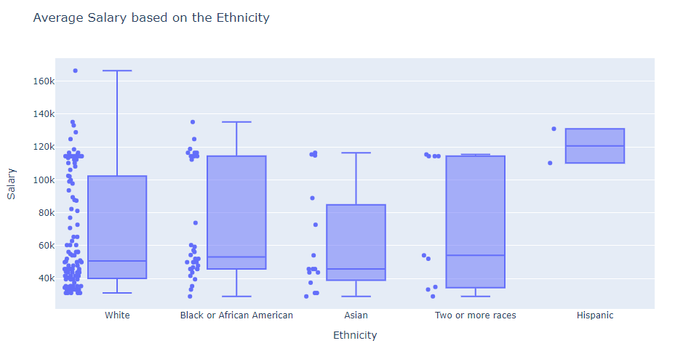
Part two: Exploratory Data Analysis 2.1) average salary visualization.
Box plot of the average salary vs. Department:
Box plot of the average salary vs. Ethnicity :

Slide 6
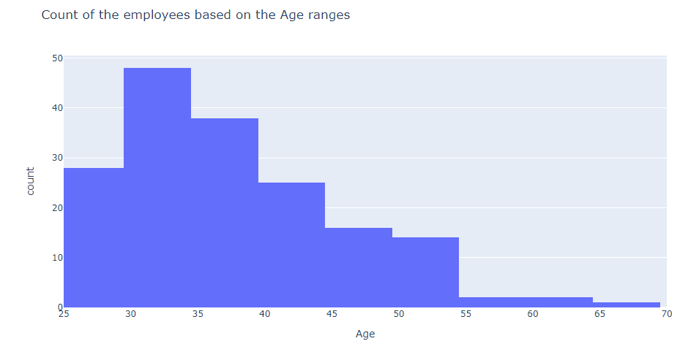
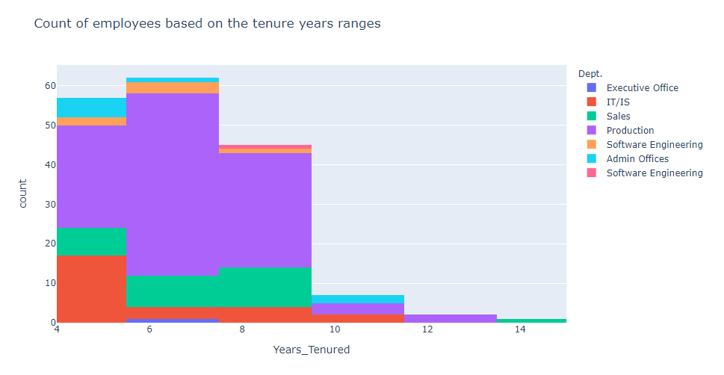
Part two: Exploratory Data Analysis 2.2) a. employees count visualization.
We split the data-set into age ranges and tenure years ranges then plotted the number of employees in each range.
Histogram of count of employees per age range:
Histogram of count of employees per tenure year range:

Slide 7
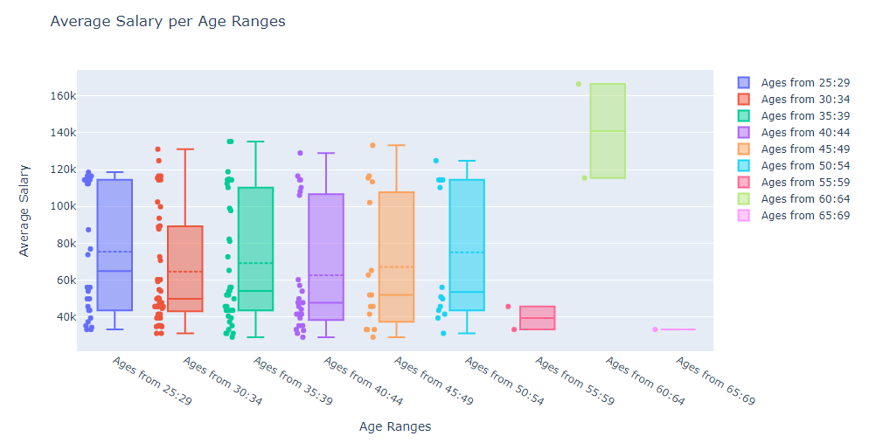
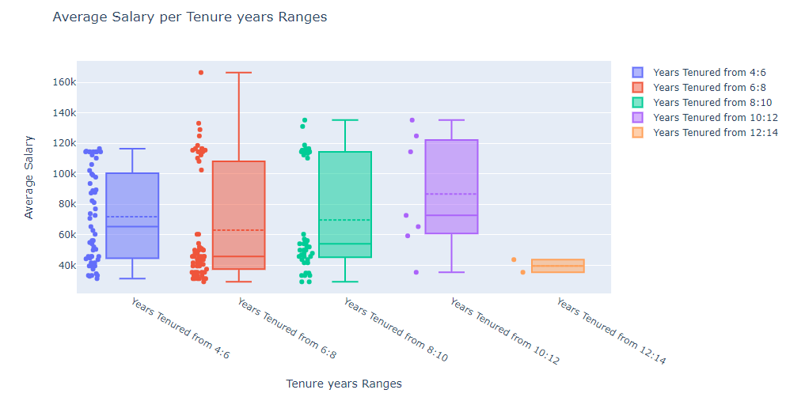
Part two: Exploratory Data Analysis 2.2) b. age & tenure years ranges’ salary visualization.
We plotted the age ranges (5 years) and tenure year ranges (2 years) vs. the salary to see the difference in salary between the ranges.
Box plot of the age ranges vs. the salary:
Box plot of the tenure year ranges vs. the salary:

Slide 8
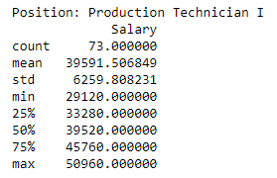
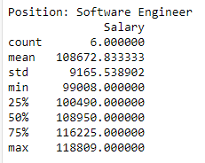
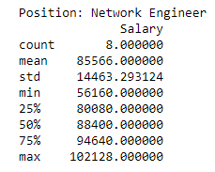
Part two: Exploratory Data Analysis 2.2) c. positions details.
We picked some positions and extracted the details of each position.
Details of production technician I:
Details Software Engineer:
Details Network Engineer:

Slide 9
PART THREE: Hypothesis Testing 3.1) hypothesis testing on gender
The null hypothesis was µ _{MaleSalary} - µ _{FemaleSalary} = 0
We split the dataset into 2 sub-datasets based on the gender column
Then we did the T-test, the T-score was = 1.260662 with DF of 172
After applying the values into the p-value calculator we get a p-value of 0.20916 which is not significant at p < 0.05

Slide 10
PART THREE: Hypothesis Testing 3.2) hypothesis testing on gender with respect to age
We split the gender sub-datasets into 4 sub-datasets with respect to the age
Then we did the T-tests, the T-scores were = 0.2328533 for the 1st test with DF of 74 and 1.41829 for the 2nd test with DF of 96
After applying the values into the p-value calculator we get a p-value of 0.816559 and 0.15937 which are not significant at p < 0.05

Slide 11
PART THREE: Hypothesis Testing 3.3) hypothesis testing on Ethnicity
The null hypothesis was µ _{WhiteSalary} - µ _{OtherSalary} = 0
We split the dataset into 2 sub-datasets based on the Ethnicity_modified column.
Then we did the T-test, the T-score was = -0.66434 with DF of 172
After applying the values into the p-value calculator we get a p-value of 0.507579 which is not significant at p < 0.05

Slide 12
PART THREE: Hypothesis Testing 3.3) hypothesis testing on Ethnicity with respect to age
We split the Ethnicity_modified sub-datasets into 4 sub-datasets with respect to the age
We did the T-tests, the T-scores were = -2.15477 for the 1st test with DF of 74 and 0.811652 for the 2nd test with DF of 96
After applying the values into the p-value calculator we get a p-value of 0.034497 which is significant at p < 0.05 and 0.419029 which is not significant at p < 0.05

